Slide 1
Study Buddy
Amin Ghassan Amin
Khaled Sameh
Ismaeel Muhammed Hossam Eldin
Moaz Alaa

Slide 2
Contents:
Features in study buddy.
Work Distribution.

Slide 3
1. Features in the study buddy:
1- Sign up.
2- Login.
3-Change account info.
4- View available books.
5- View available tools.
6- View his books.
7- View his tools.
8- Add available books to cart.
9- Add available tools to cart
10- Remove items from cart
11- Obtain his cart.
12- Lend books.
13- Lend tools.
14-Request unavailable books.
15-Request unavailable tools.
16-Viewing and responding to requests from other users.
17-Viewing the profile of the requesting user.
18-Rating users.
19-Searching users.
20-Sorting users.
21-Searching books.
22-Sorting books.
23-Searching tools.
24-Sorting tools
25-Logging out.

Slide 4
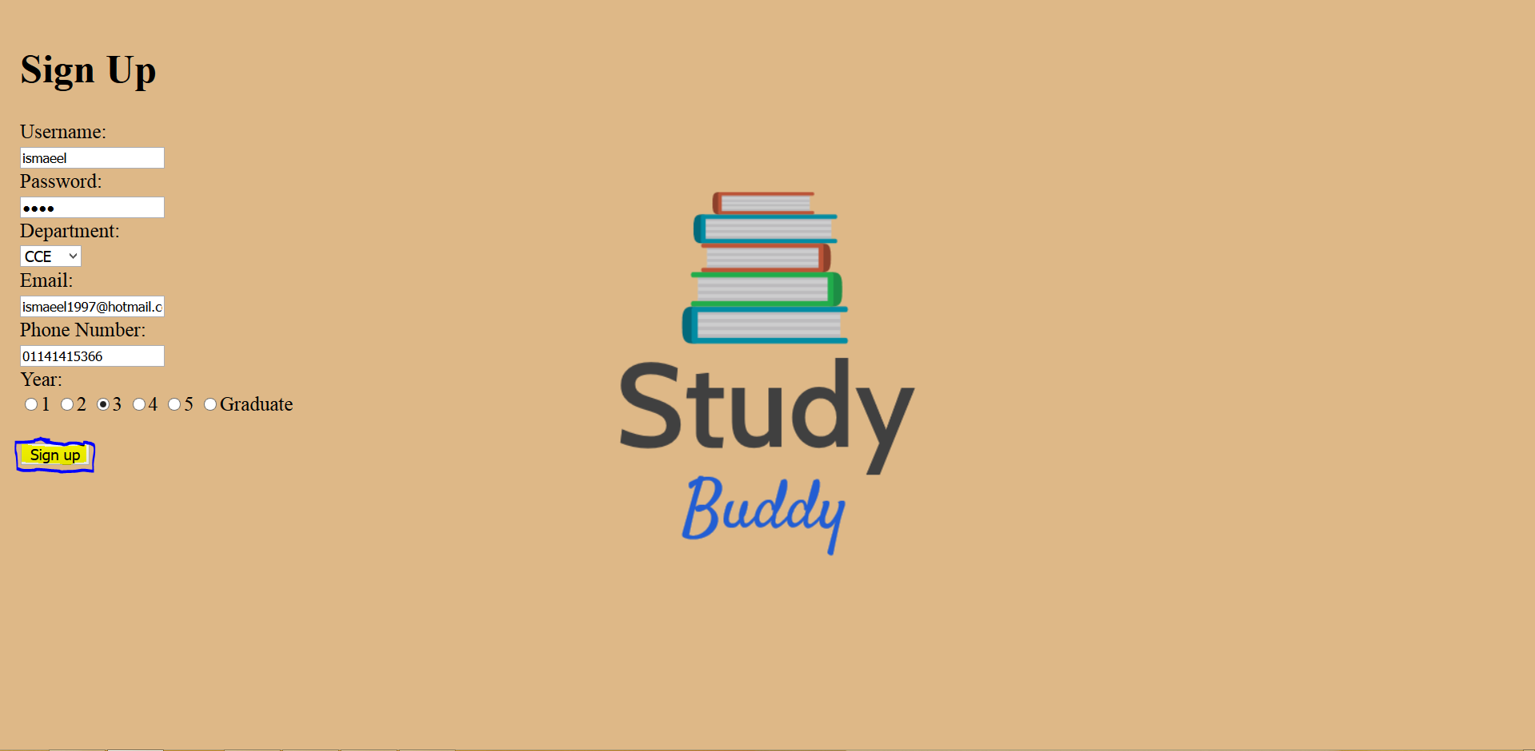
1-Sign up

Slide 5
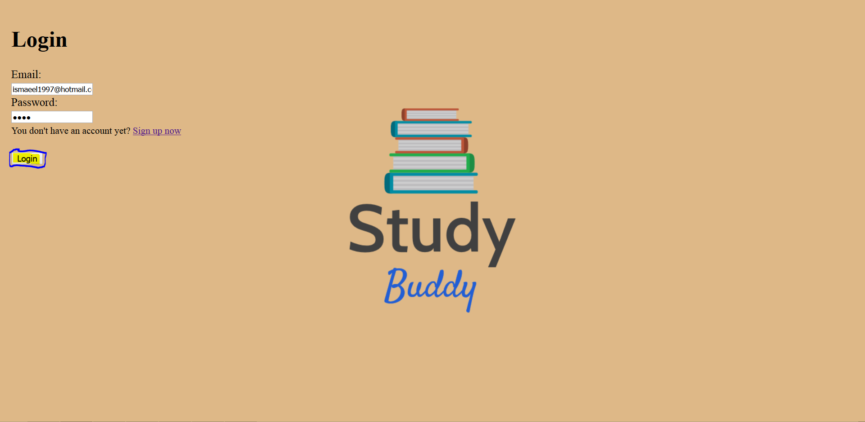
2-Login

Slide 6
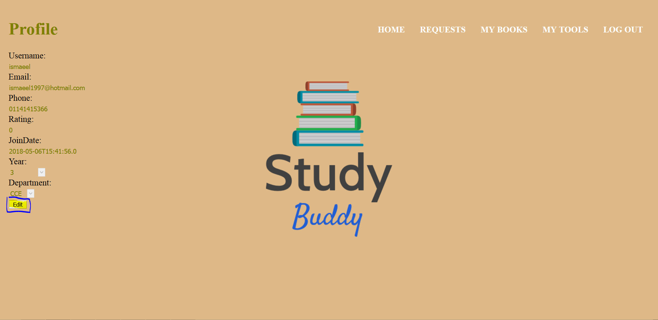
3-Change account info

Slide 7
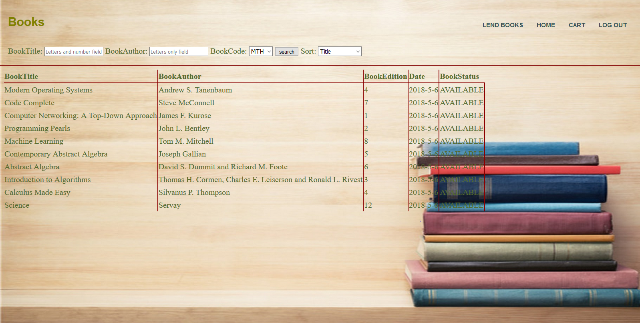
4-View available books

Slide 8
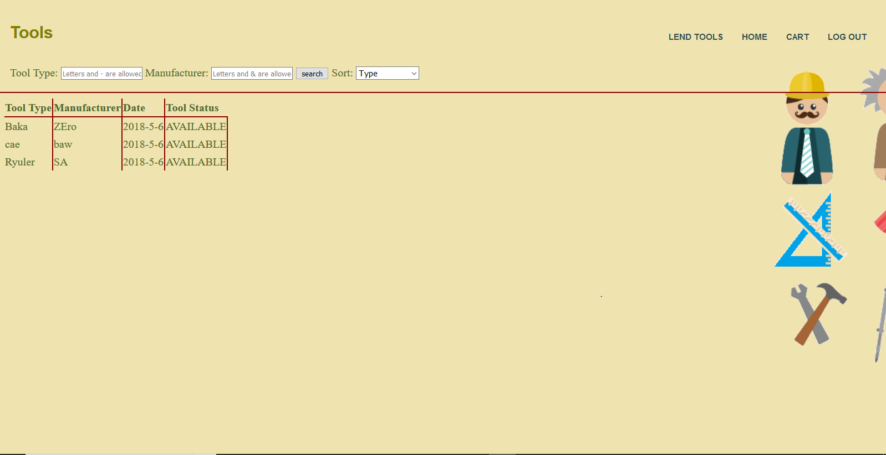
5-View available tools

Slide 9
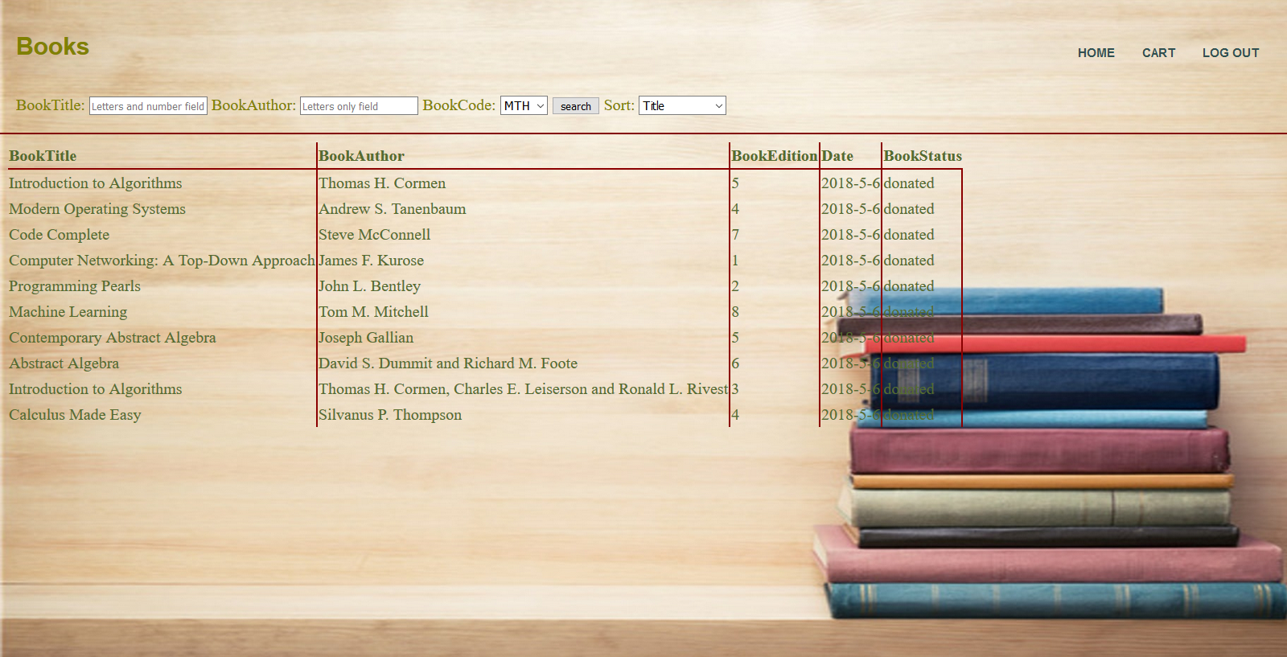
6-View my books

Slide 10
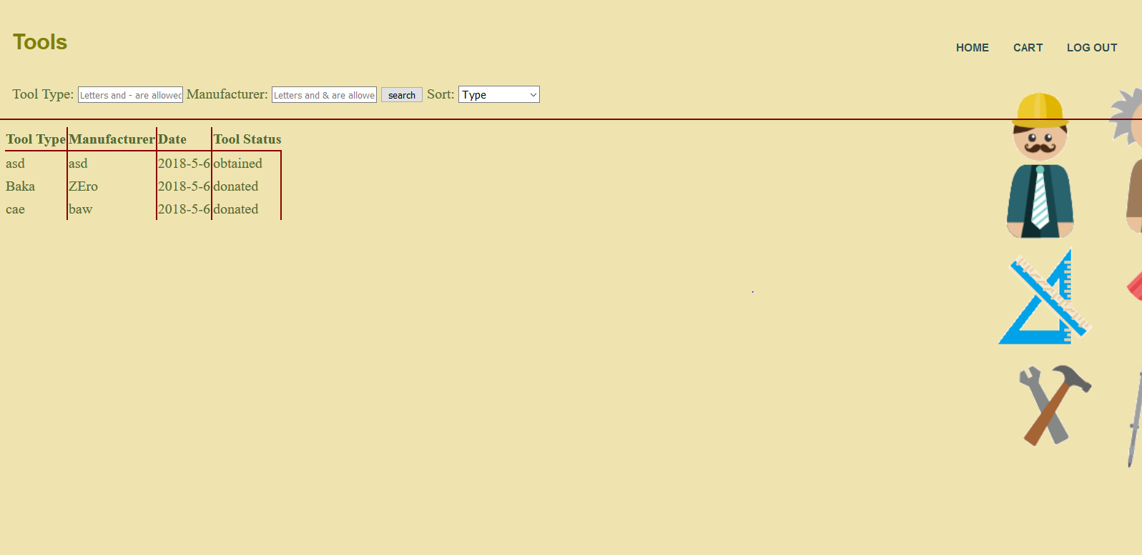
7-View my tools

Slide 11
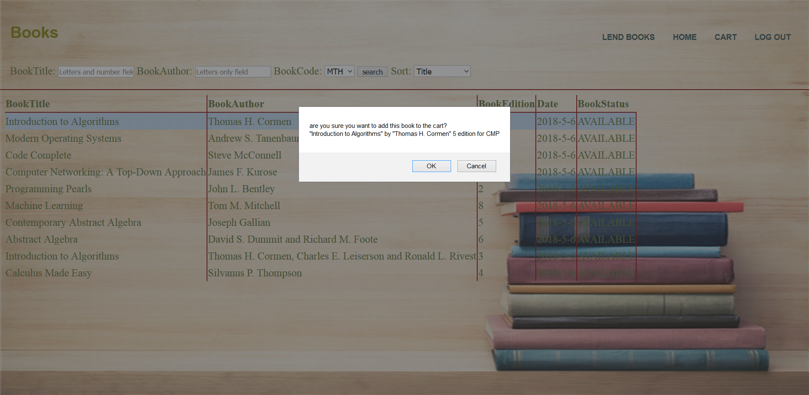
8-Add books to cart

Slide 12
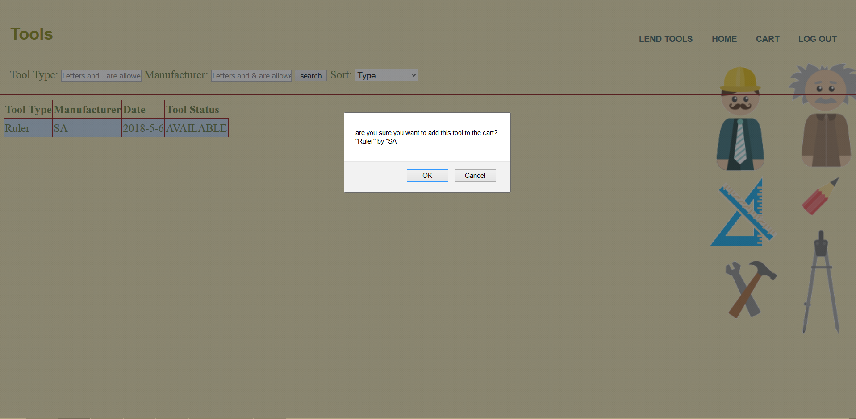
9-Add tools to cart

Slide 13
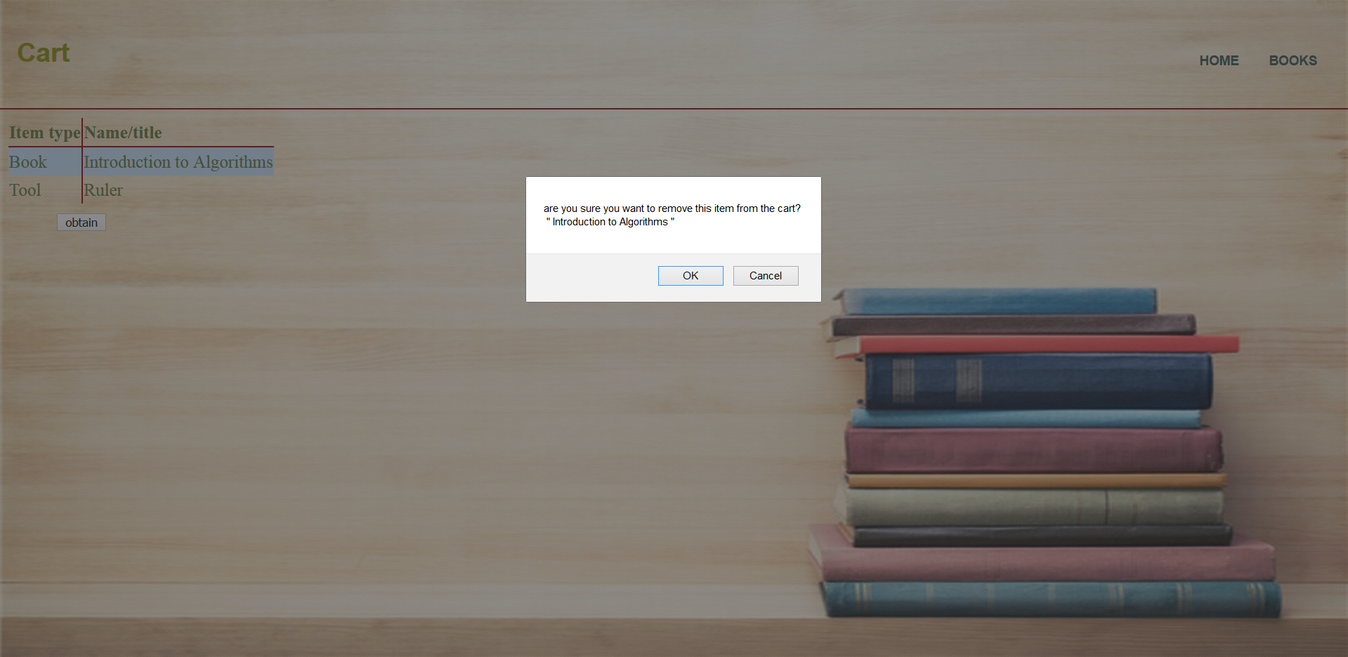
10-Remove items from cart

Slide 14
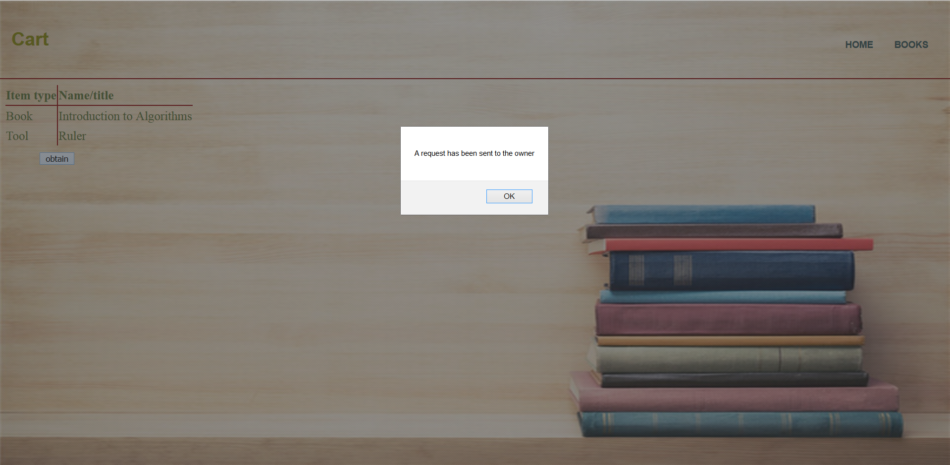
11-Obtain items

Slide 15
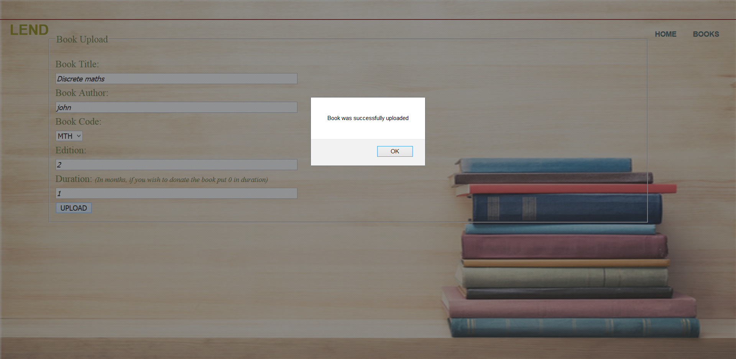
12-Lending books

Slide 16
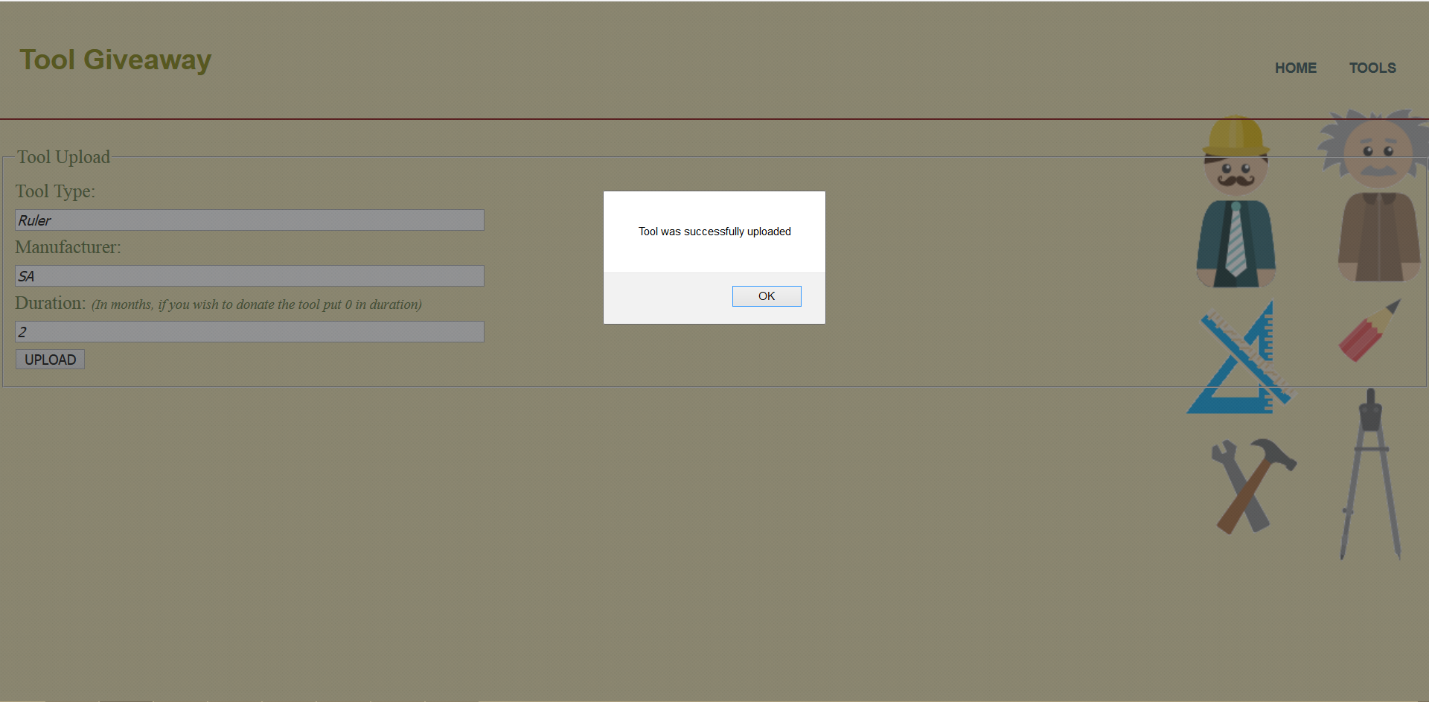
13-Lending tools

Slide 17
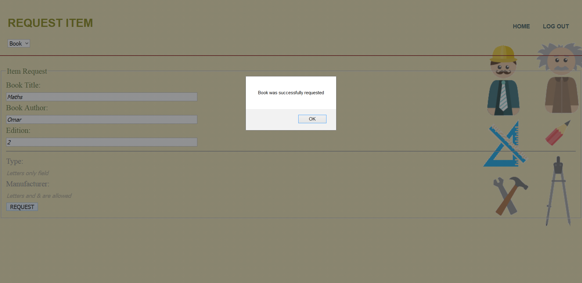
14-Request unavailable books

Slide 18
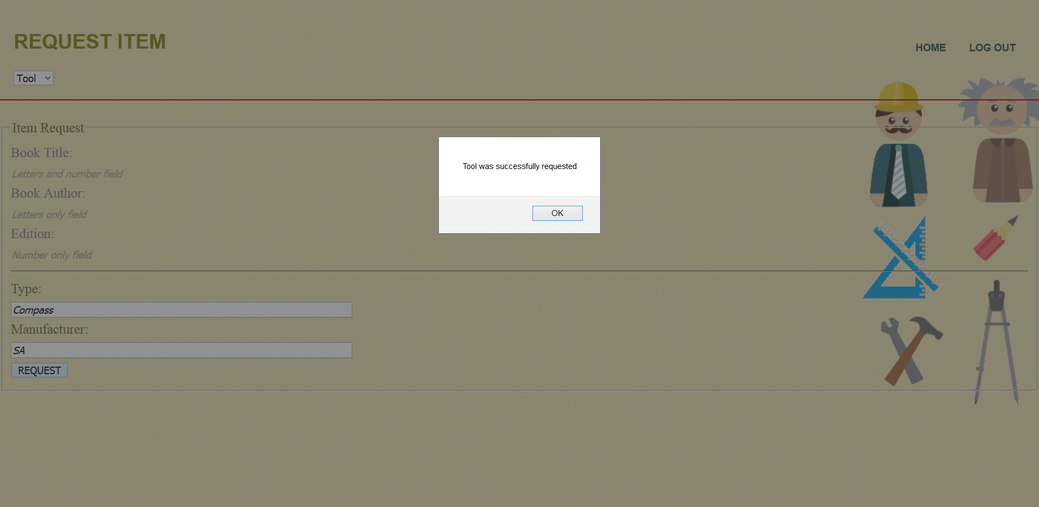
15-Request unavailable tools

Slide 19
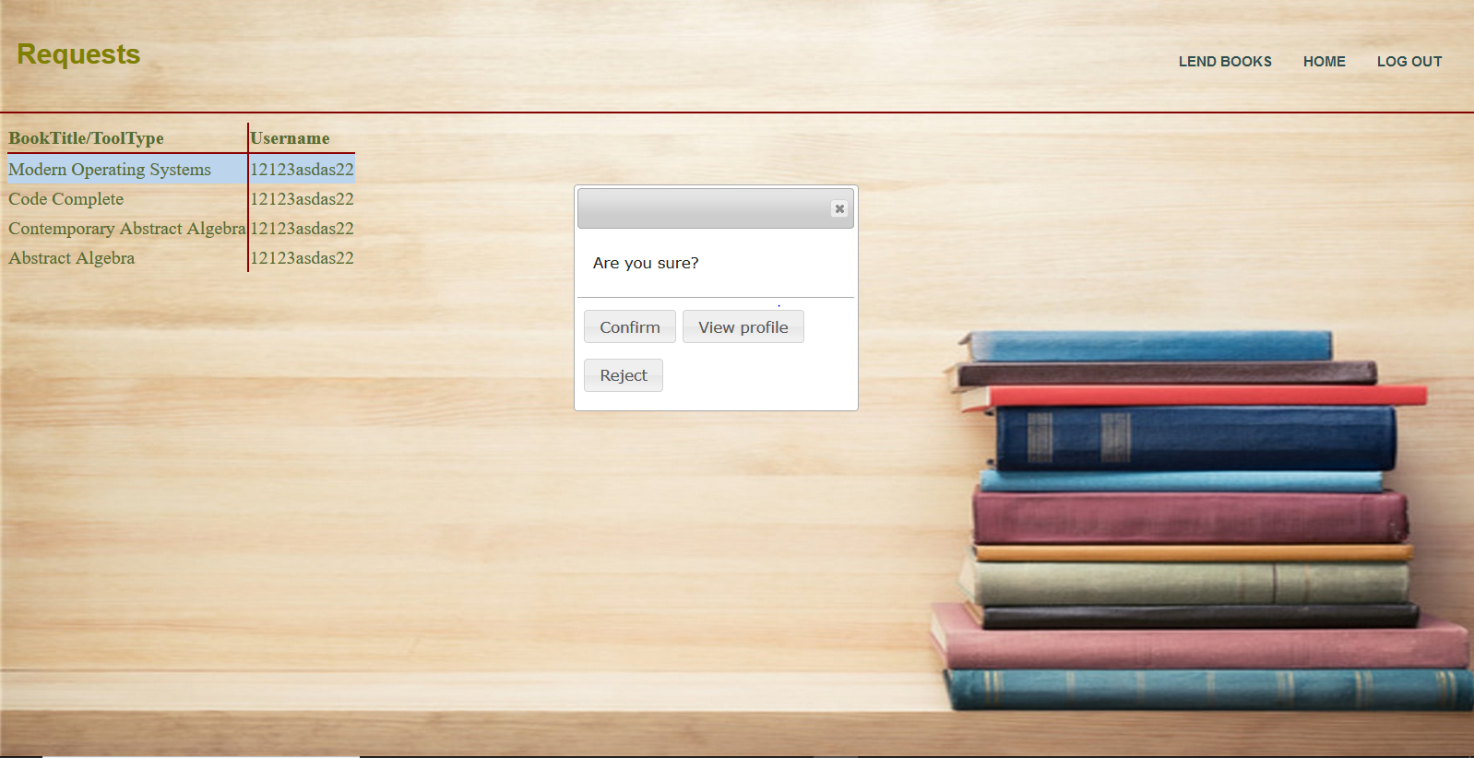
16-Viewing and responding to requests from other users

Slide 20
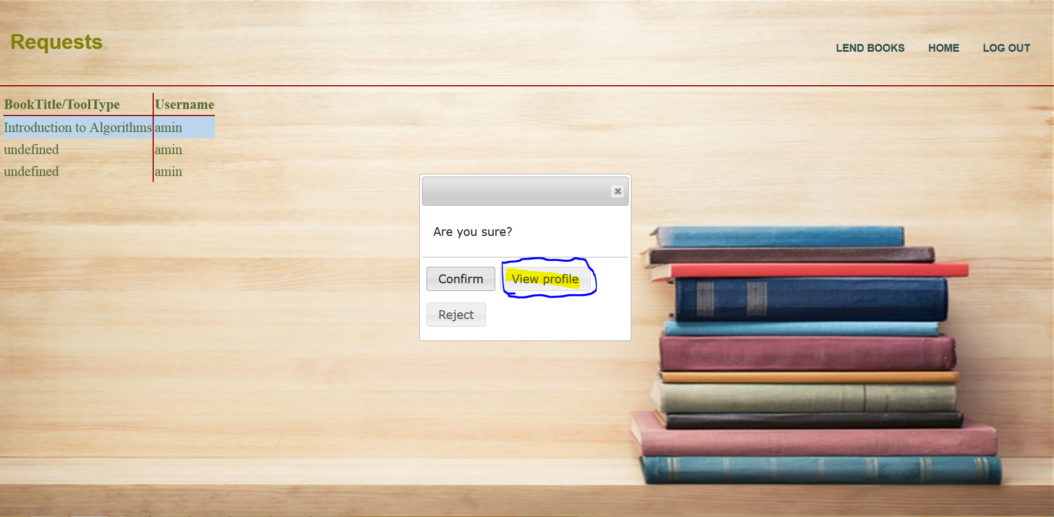
17-Viewing Profile of requesting user

Slide 21
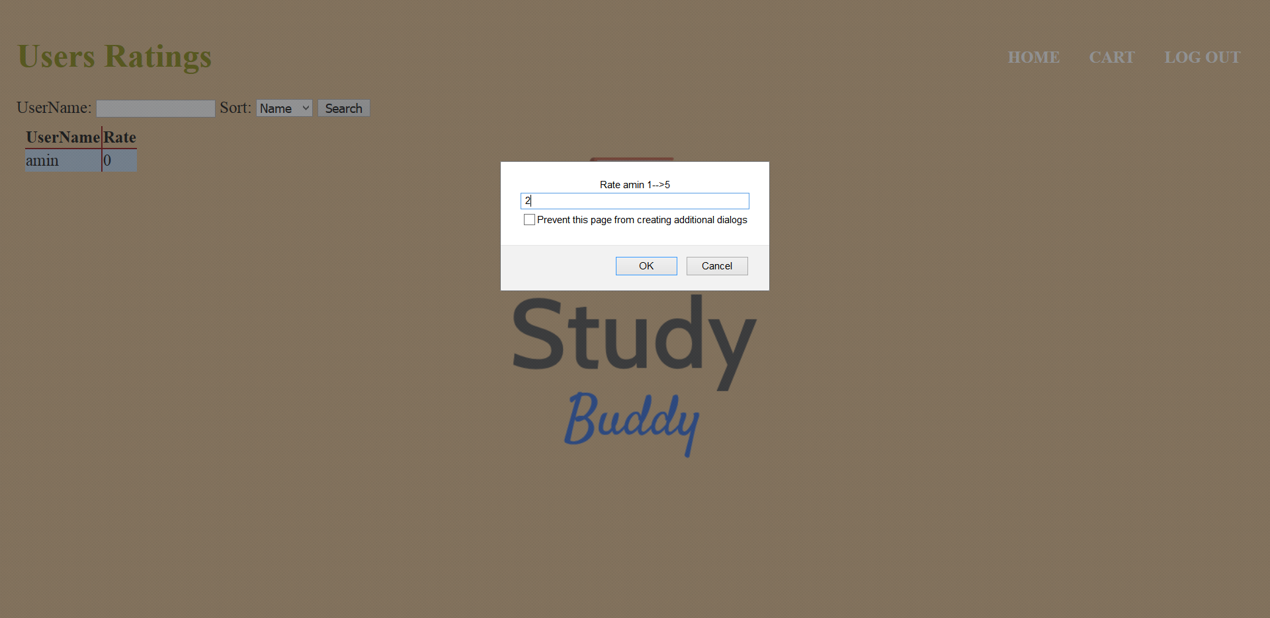
18-Rating users

Slide 22
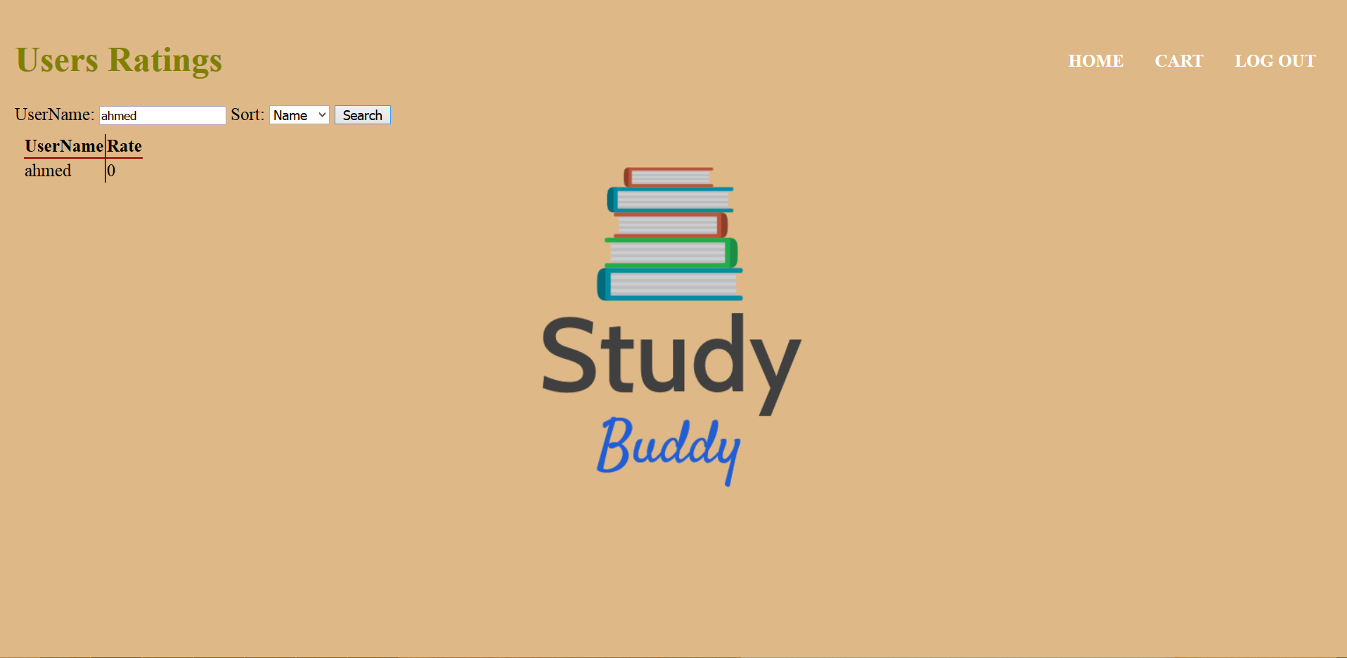
19-Searching users

Slide 23
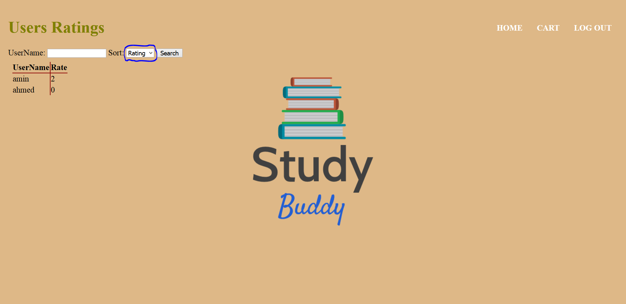
20-Sorting users

Slide 24
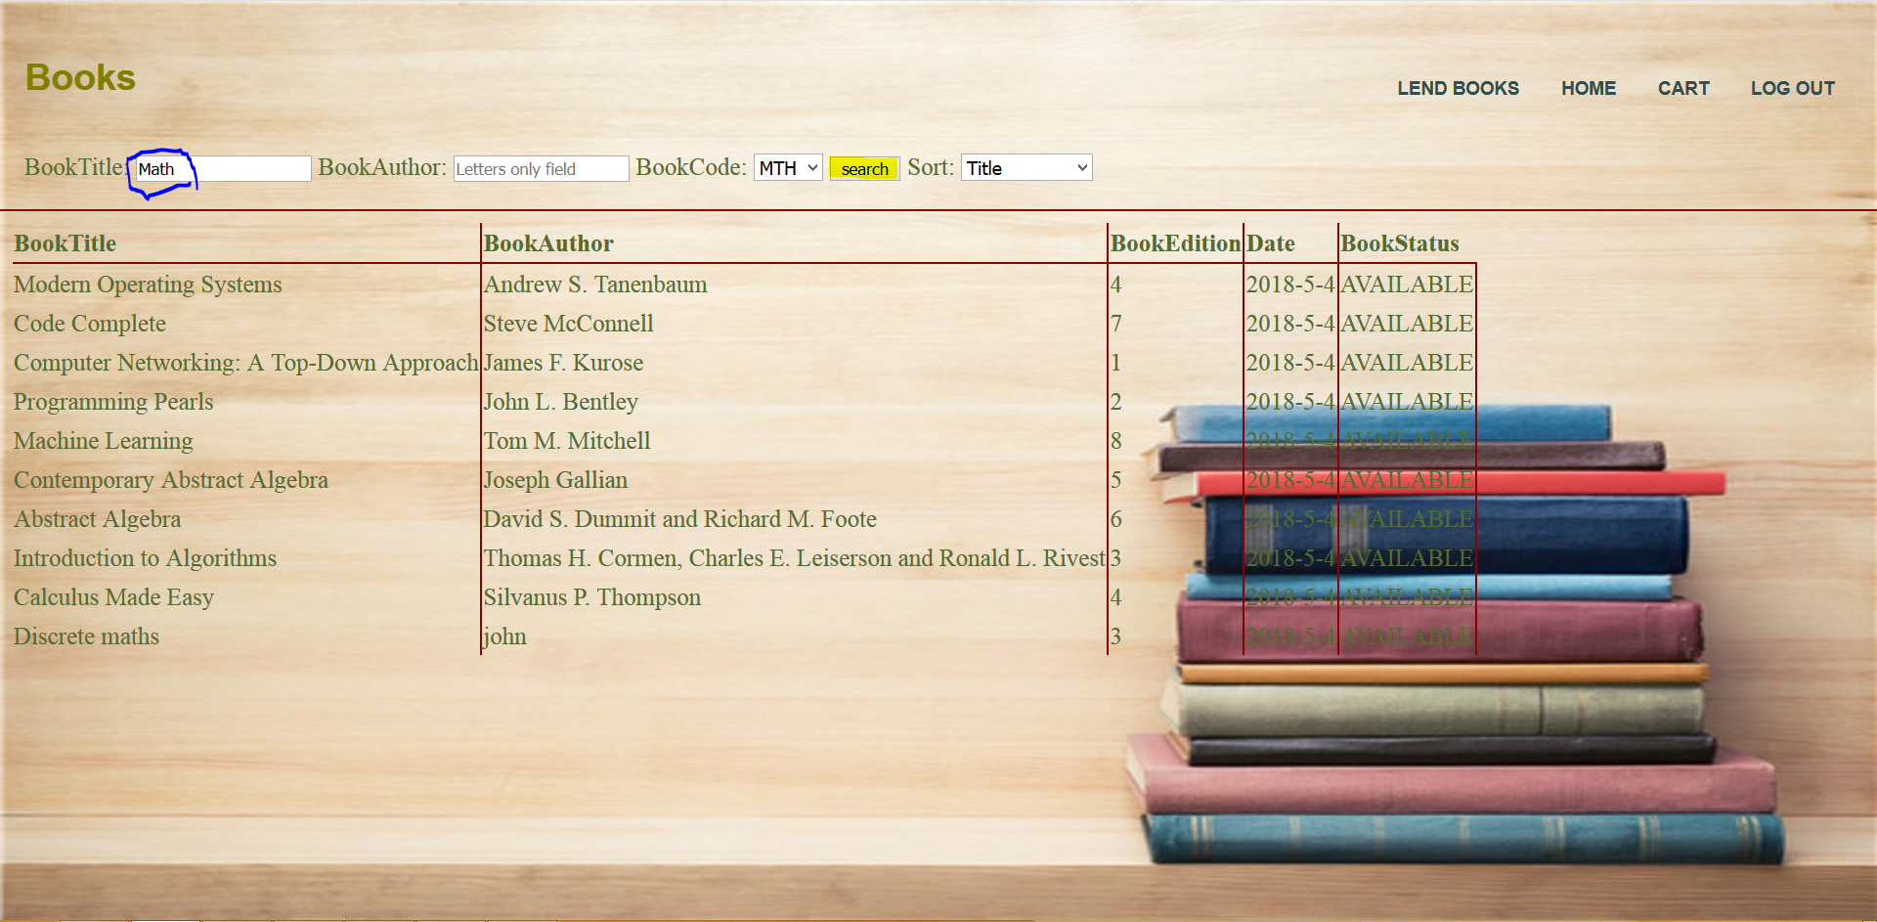
21-Searching Books

Slide 25
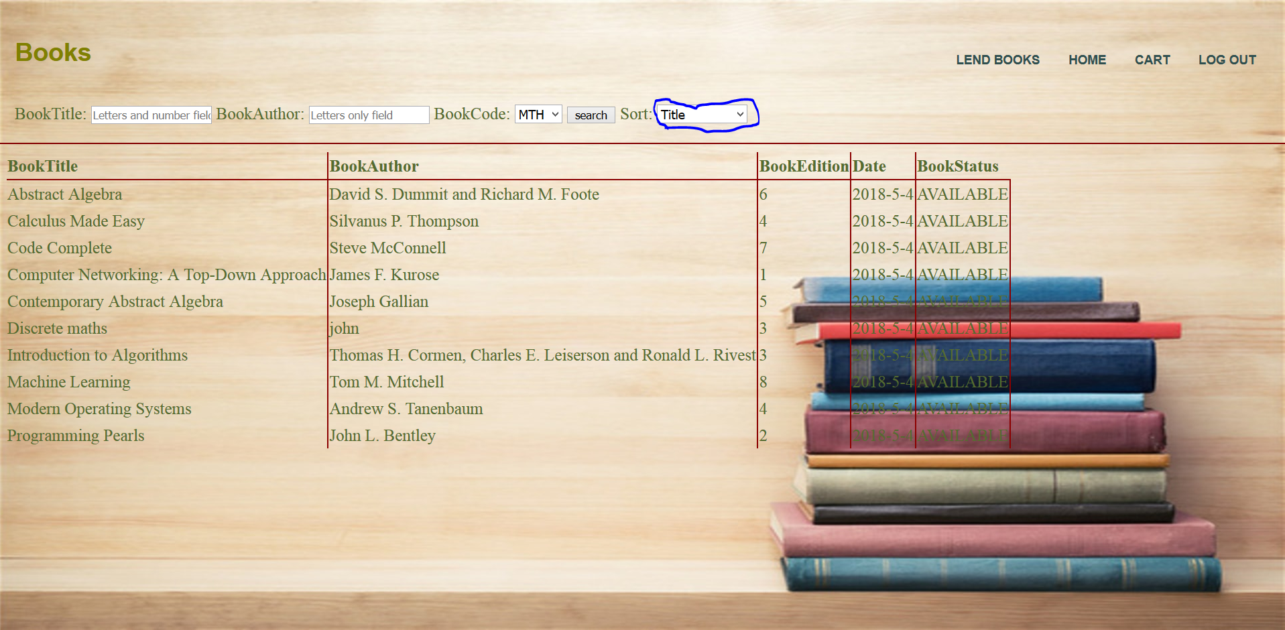
22-Sorting Books

Slide 26
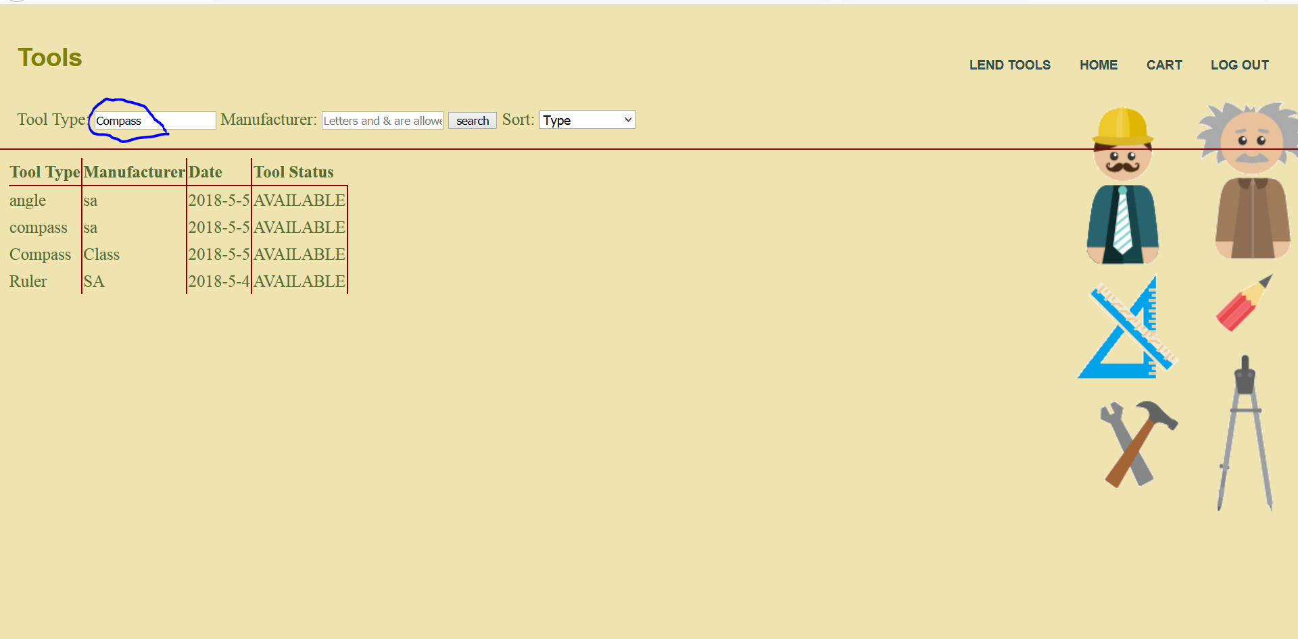
23-Searching tools

Slide 27
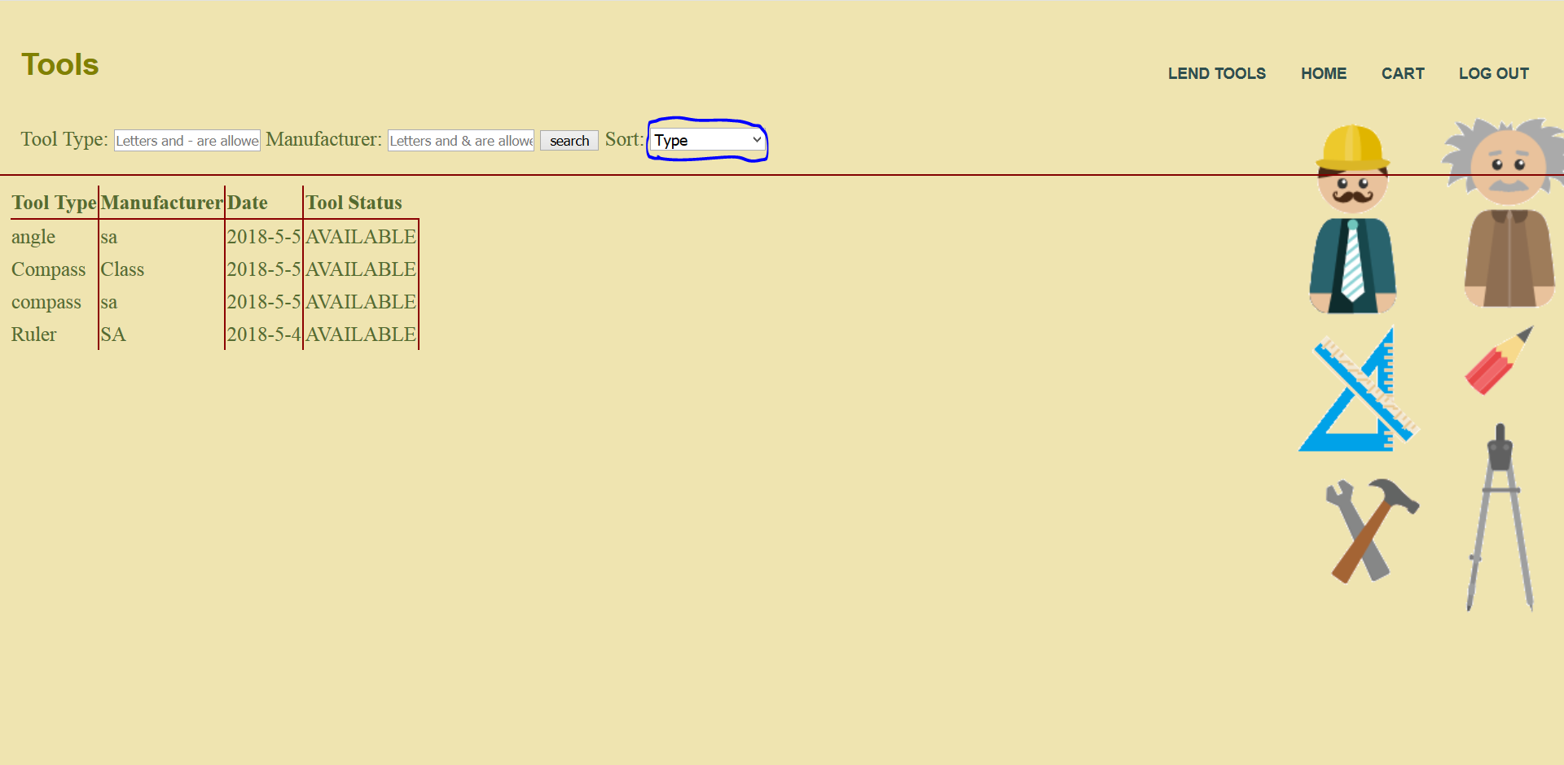
24-Sorting tools

Slide 28
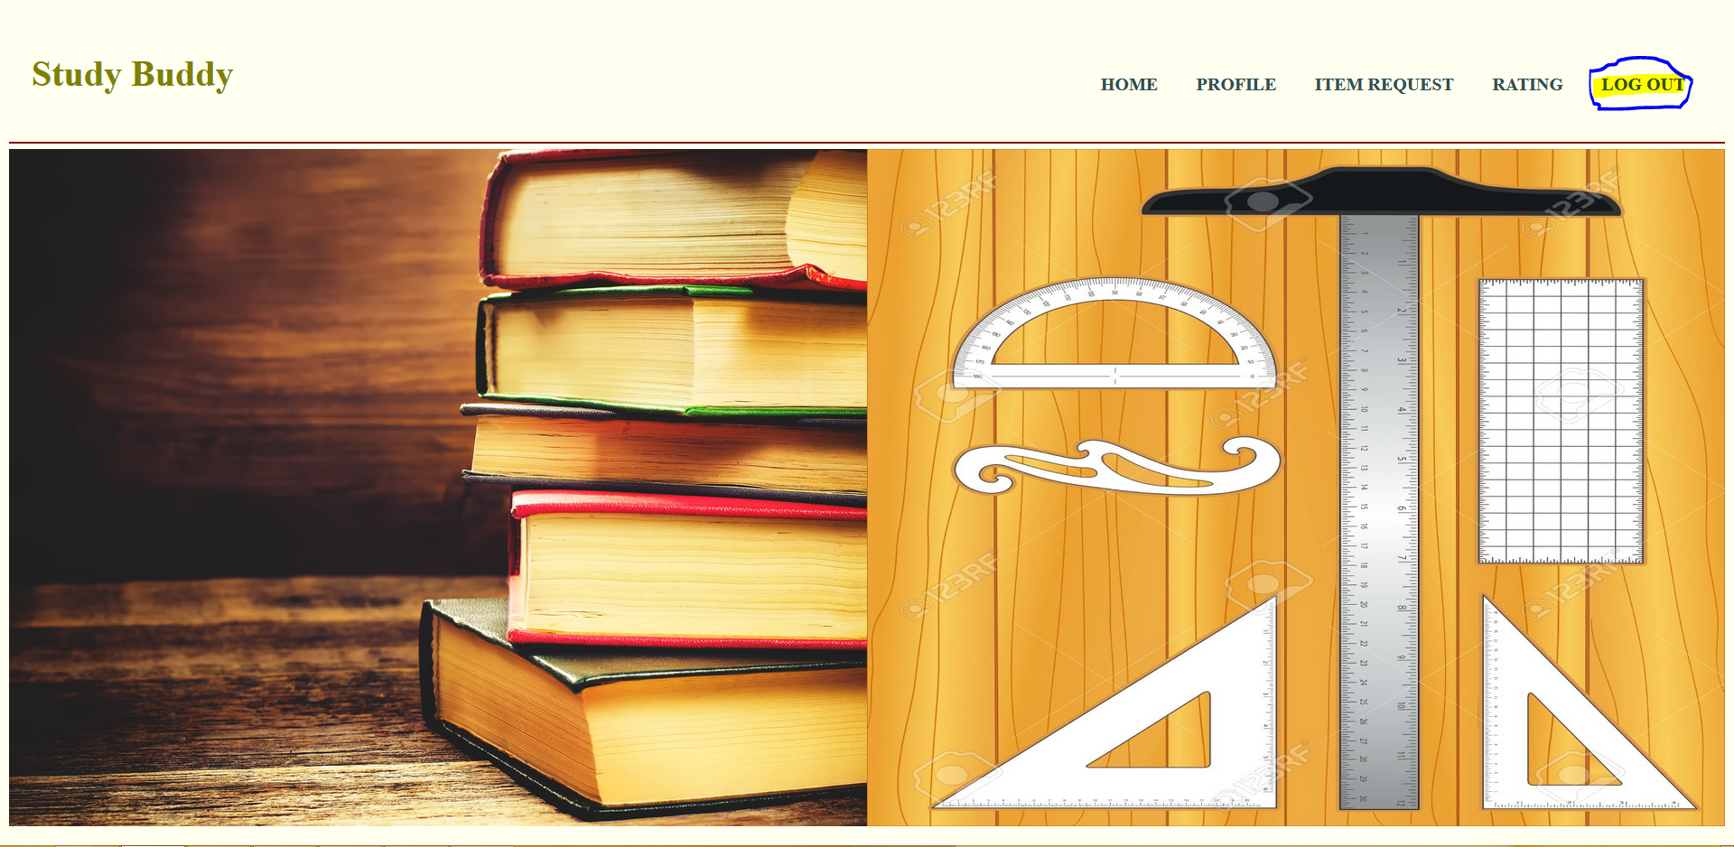
25-Logging out

Slide 29
2.Work Distribution: Amin Ghassan
Profile front end.
My books.
My tools.
Rating users front end.
Request unavailable items.

Slide 30
Khaled Sameh:
Change design of web site.
Format validations on all fields in the web site.
Tools implementation.

Slide 31
Ismaeel Muhammed Hossam Eldin:
Add to cart.
Remove from cart.
Obtain cart.
Responding to requests.

Slide 32
Moaz Alaa:
Creating the Server and routes
Signup back-end + Validations for correct email
Login back-end
Profile back-end
Rating users back-end + DB table creation
Books back-end
Cart back-end
Verification tokens (for all back-end)
Sending all emails (signup - obtain)
Logo design

